Slide 1
Holidays
3 класс
Учитель: Москалёва Н. В.
Учебник: Верещагина

Slide 2
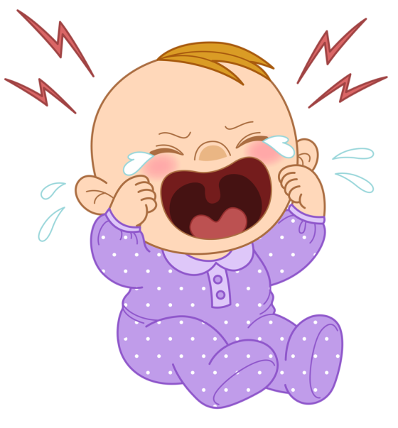
Речевая разминка
Why do you cry Willy?
Why do you cry?
Why Willy? Why Willy?
Why, Willy, why?

Slide 3
Правила чтения
sh
ch
ship
fish
she
shark
cheese
children
chocolate
champion

Slide 4
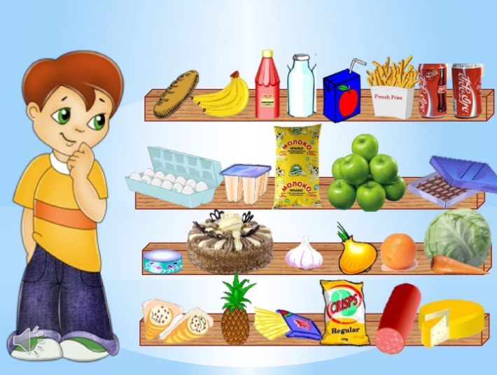
I bought … yesterday.

Slide 5
Неправильные глаголы
I форма | II форма | Перевод
buy |  | покупать
have |  | иметь
can | could
be |  | быть
give | gave

Slide 6
Проверка домашнего задания
tomato – помидор
people – люди
berry – ягода
country – страна
right food – правильная еда
proverb - поговорка

Slide 7
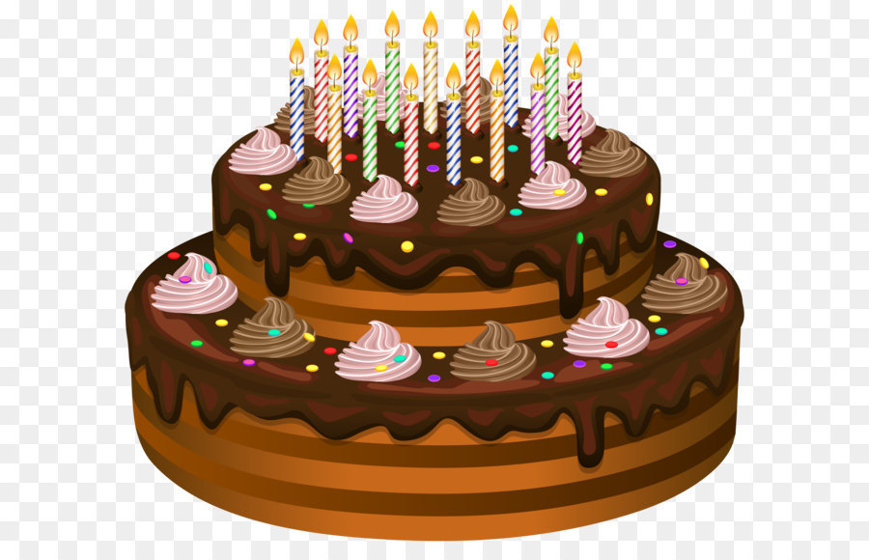

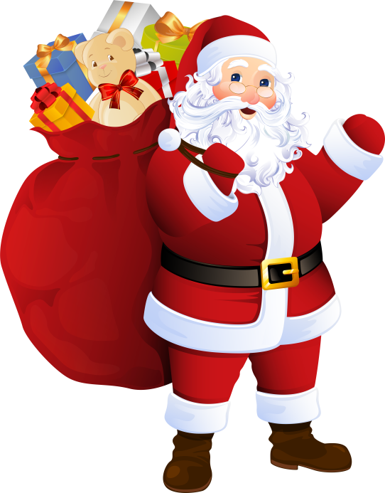
Holidays

Slide 8
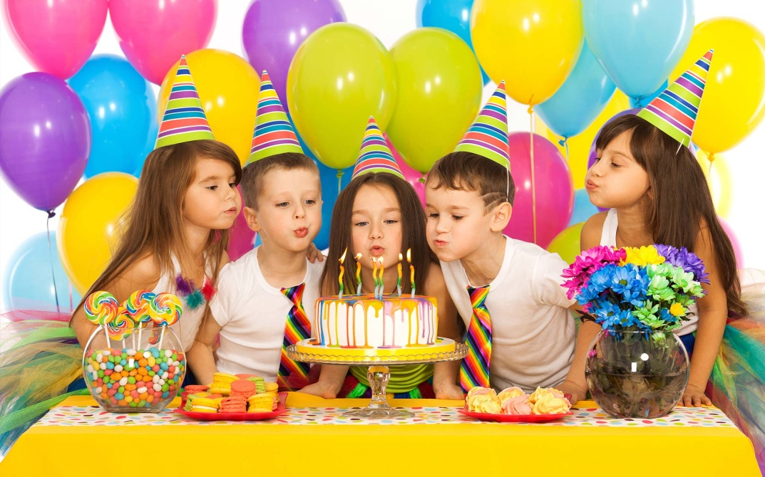
Say:
I had a party last week.

Slide 9

Say:
I sent a big doll to Alice.

Slide 10

Happy birthday to you!

Slide 11


To Mike
Please come to my birthday party
on 5th of Desember
from 5.00 till 7.00
at Kalinina Street.
From Nastya

